Slide 1



INTELLIGENT CUSTOMER SUPPORT CHATBOT FOR E-COMMERCE PLATFORMS
Enhancing Customer Satisfaction through AI-Driven Solutions
by Rochelle Awuor
C027-01-1130/2021

Slide 2
The e-commerce challenge
1.Rapid Growth of the E-Commerce Sector:
Increasing number of online shoppers and transactions.
Emergence of new platforms and marketplaces catering to diverse consumer needs.
2.Importance of Efficient and Personalized Customer Support:
Customer expectations have risen with the growth of e-commerce.
Quick and accurate responses are crucial for maintaining customer loyalty.
Personalized interactions increase customer satisfaction and repeat purchases.
3.Challenges Faced by Traditional Customer Support Systems:
High Inquiry Volumes: E-commerce platforms receive a large number of customer queries daily, overwhelming traditional support teams.
Long Wait Times: Manual handling of inquiries often results in delays, frustrating customers.
Inconsistent Service: Variability in responses due to human factors can lead to dissatisfaction and loss of trust.

Slide 3
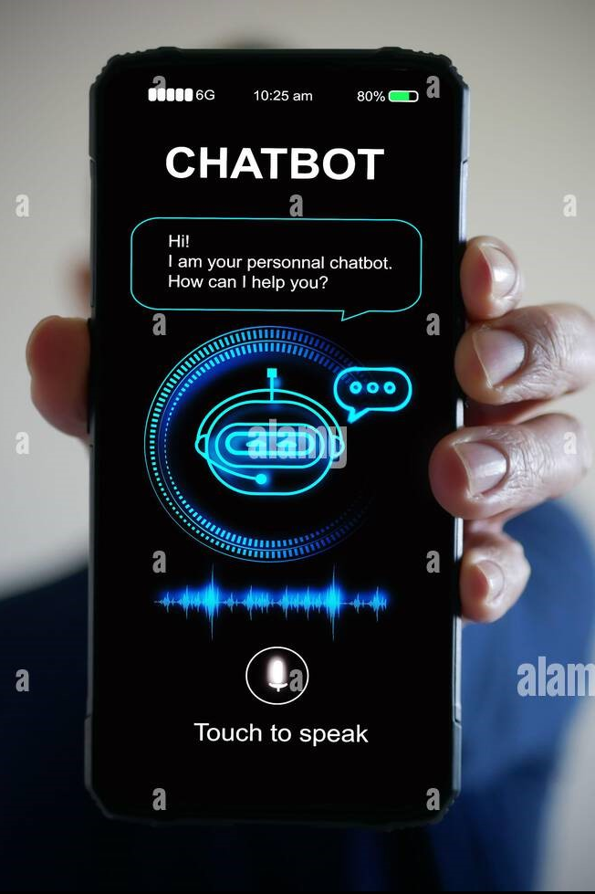
The Rise of chatbots
1.Emergence of Chatbots in the Early 2010s:
Introduction of Chatbots: Chatbots began to be adopted widely by businesses around the early 2010s as part of their customer support strategy.
Adoption in E-Commerce: E-commerce platforms recognized the potential of chatbots to manage large volumes of inquiries efficiently, leading to their increased use.
2.Role of AI in Transforming Customer Service:
Natural Language Processing (NLP): AI advancements, particularly in NLP, have enabled chatbots to understand and process human language more effectively, making interactions more natural.
Machine Learning (ML): ML allows chatbots to learn from past interactions, improving their accuracy and relevance over time.

Slide 4
Chatbot Capabilitiess
1.Handles a Wide Range of Queries:
Product Information: The chatbot can provide detailed information about products, including specifications, availability, pricing, and comparisons, helping customers make informed purchasing decisions.
Order Tracking: Customers can inquire about the status of their orders, including shipping updates and estimated delivery dates, enhancing transparency and trust.
Troubleshooting: The chatbot assists customers with technical issues or product malfunctions, offering step-by-step solutions and guidance to resolve problems effectively.
Returns Processing: It streamlines the return process by providing instructions and requirements, making it easier for customers to initiate returns or exchanges.
2.Integration with the E-Commerce Platform's Database:
Real-Time Access to Data: By connecting to the e-commerce platform's database, the chatbot retrieves up-to-date information, ensuring that responses are accurate and relevant.
Personalized Interactions: The integration allows the chatbot to access customer profiles, order histories, and preferences, enabling personalized recommendations and support based on individual user data.

Slide 5

Benefits and impacts
1.Automation of Routine Tasks:
Efficiency Gains: Chatbots automate repetitive inquiries such as FAQs, order status requests, and basic troubleshooting, allowing for faster response times and freeing up resources.
Consistent Service Quality: Automation ensures that customers receive consistent answers to common questions, reducing the variability that can occur with human agents.
2.Instant, Personalized Assistance:
Immediate Response: Customers no longer need to wait in long queues for assistance; chatbots provide instant responses, improving overall satisfaction.
24/7 Availability: Chatbots operate around the clock, allowing customers to receive assistance at any time, which is particularly important for global e-commerce businesses.

Slide 6

Future developments
1.Voice Interaction:
Hands-Free Convenience: Integrating voice interaction capabilities will allow customers to engage with the chatbot using voice commands, enhancing accessibility and ease of use.
Integration with Smart Devices: The chatbot can be designed to work with smart speakers and mobile devices, allowing users to get assistance while multitasking or on the go.
2.Multilingual Support:
Catering to Global Audiences: As e-commerce expands globally, offering multilingual support will enable businesses to reach a wider audience and improve customer satisfaction across different regions.
Cultural Sensitivity: Providing support in multiple languages allows the chatbot to better understand and respond to cultural nuances, improving the overall customer experience.

